Slide 1
In-class Exercise 03 - Point Transformation
-Dhiren Gupta
800902466

Slide 2
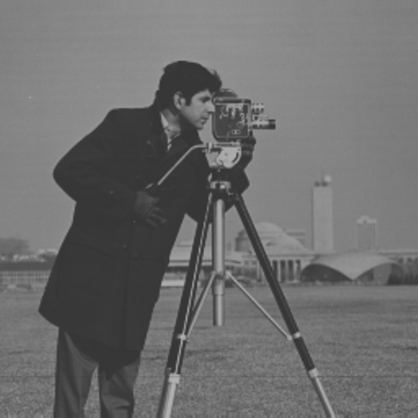
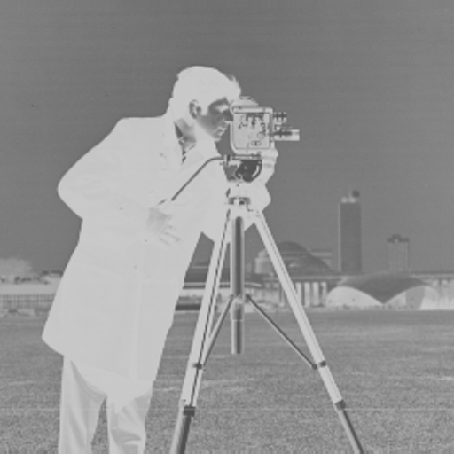
Corrupted Image 1
Original
Inversed Image

Slide 3
Analysis
For the corrupted image 1 inverse transformation is used.
I’(x,y)=255-I(x,y)
Sum of squared difference for this is 0
uint8(sum(sum((double(255-og)-double(crpt1)).^2)))
Where og= original image
Crpt1= corrupt1 image

Slide 4
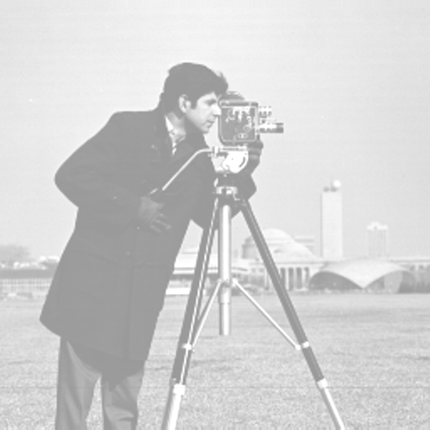
Corrupt Image 2
Original
Add intensity

Slide 5
Analysis
For the corrupted image 2 intensity is added
Amount of intensity added is 100
I’(x,y)=I(x,y)+100
Sum of squared difference for this is 0
uint8(sum(sum((double(second)-double(crpt2)).^2)))
Where second= og+100
og= original image
Crpt2= corrupt2 image

Slide 6
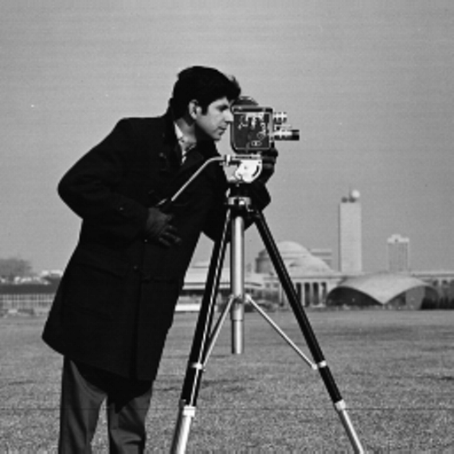
Corrupt Image 3
Original
linear contrast stretch

Slide 7
Analysis
For the corrupted image 3 linear contrast stretch transformation is used
I’(x,y)=(255/(gmax - gmin) * (I(x,y)- gmin))
Sum of squared difference for this is 0
uint8(sum(sum((temp-crpt3).^2)))
Where temp= (255/(gmax - gmin) * (og - gmin));
gmin = min(min(og));
gmax = max(max(og));
og= original image
Crpt3= corrupt3 image

Slide 8
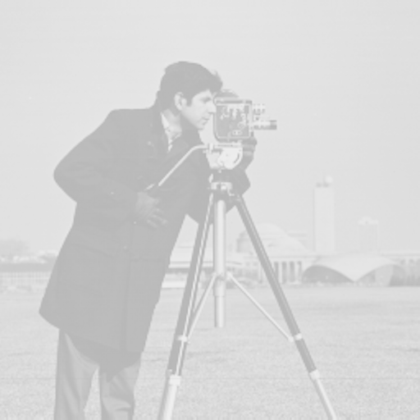
Corrupt Image 4
Original
Log transformation

Slide 9
Analysis
For the corrupted image 1 Log transformation is used.
uint8(255/c*log(double(og)+1));
Sum of squared difference for this is 0
sum(sum(double(temp)-double(crpt4)).^2)
Where temp=uint8(255/c*log(double(og)+1));
C=log(256);
og= original image
Crpt4= corrupt4 image

Slide 10
Thank You

